Slide 1
Topic 3: Next-gen Sequencing Technologies Bioinformatics Applications (PLPTH813)
Sanzhen Liu
1/28/2025

Slide 2

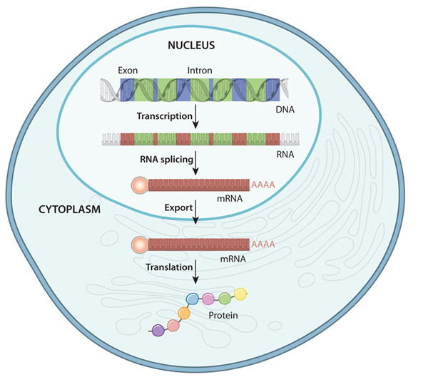
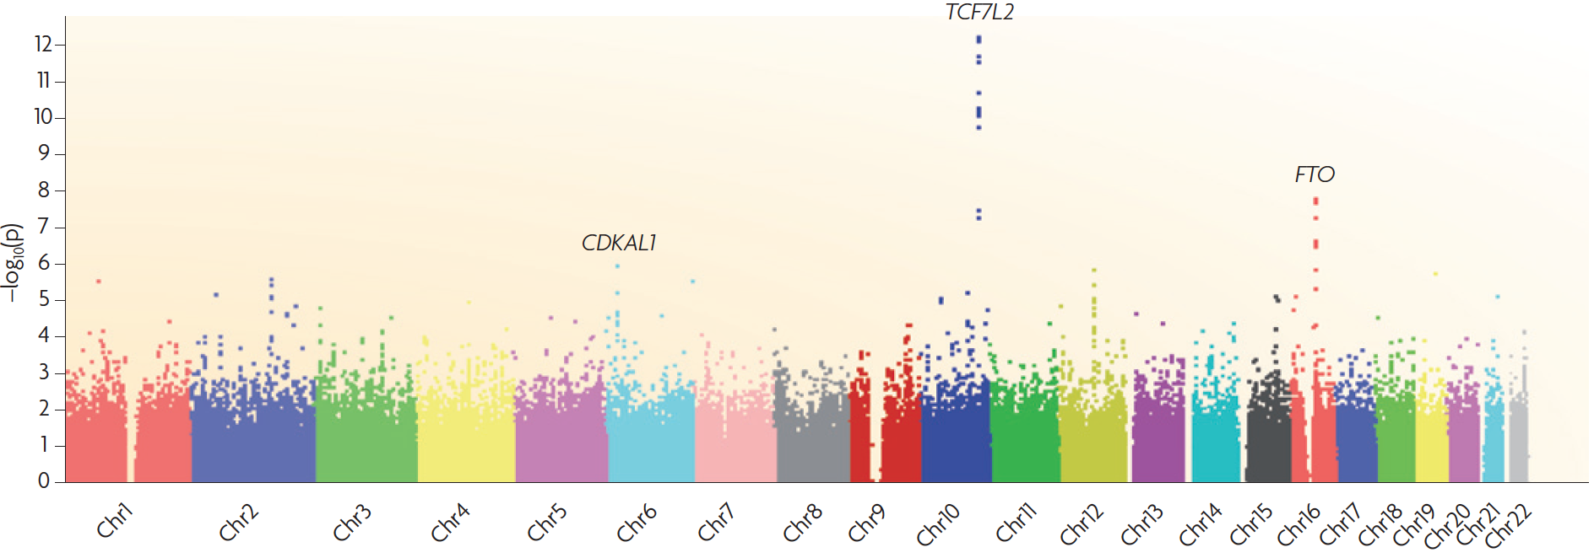
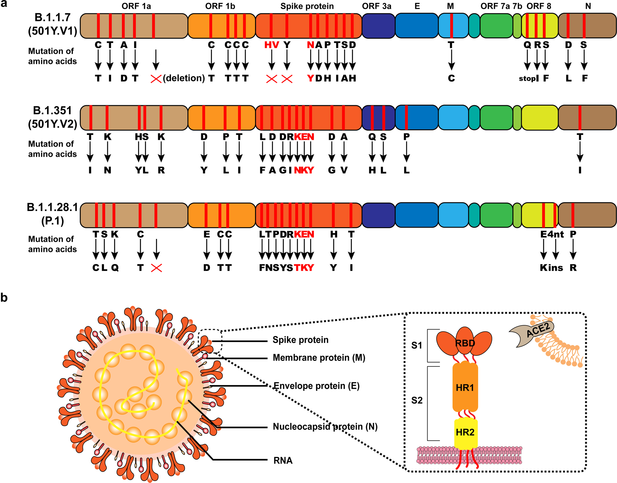


The sequencing technology is key for a wide range of biological researches

Slide 3
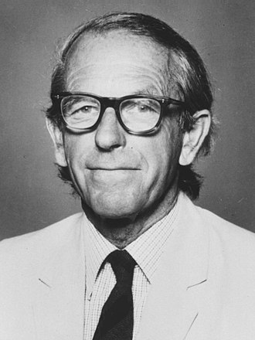
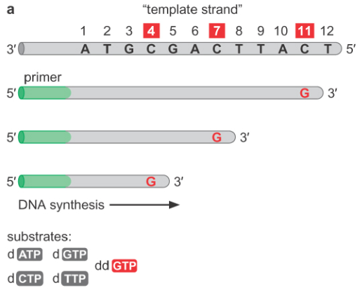
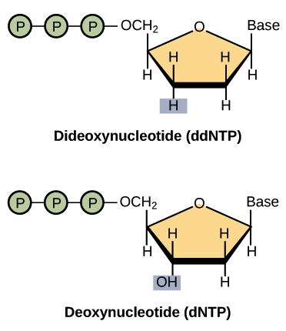
Sanger sequencing technology - I
Frederick Sanger
Key innovation
Notes:
Hydroxide

Slide 4
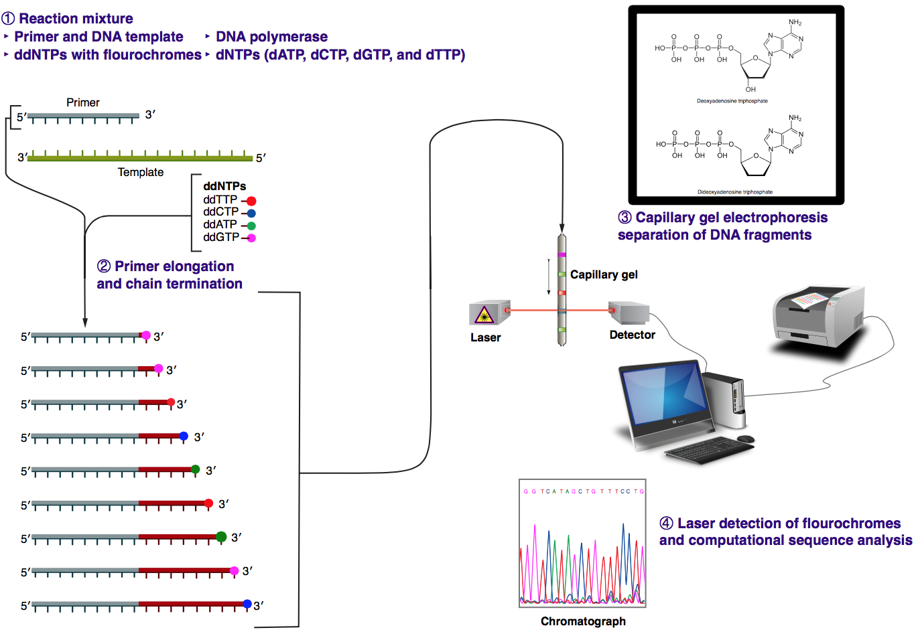
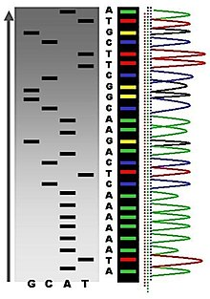
Sanger sequencing technology - II
x
wikipedia
Notes:
Hydroxide

Slide 5
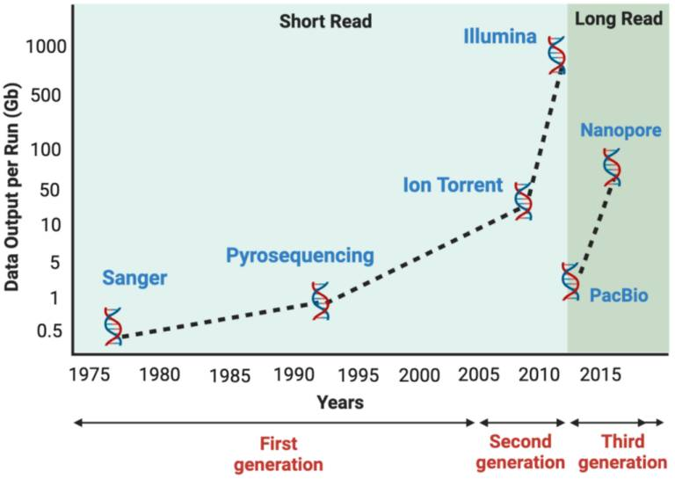
Next-gen sequencing (NGS) technologies
Illumina
Satam et al., 2023, Biology, 12(7):997
Notes:
Jonathan Rothberg (454 + Ion Torrent)

Slide 6



Major next-gen sequencing (NGS) technologies
Notes:
Jonathan Rothberg (454 + Ion Torrent)

Slide 7
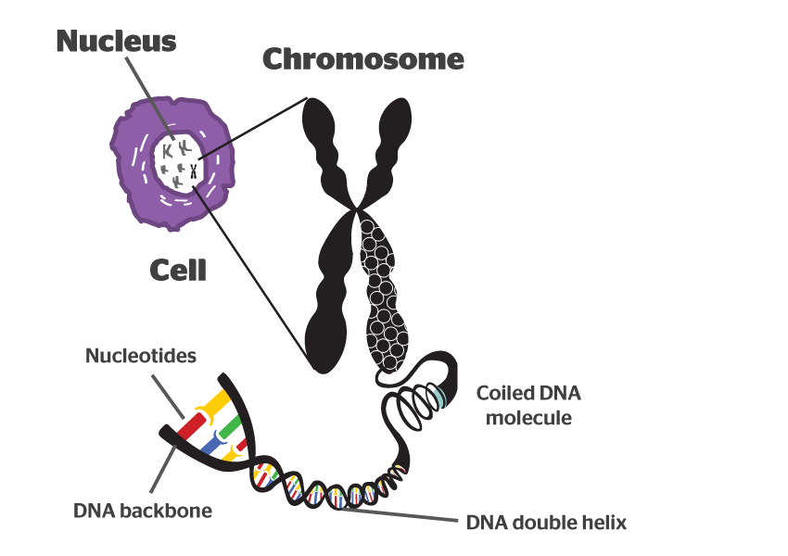
Highly sensitive and nonstop reading Before single molecular & "super long" sequencing technologies, fragmentation and amplification/cloning of a single nucleotide molecule are needed for sequencing.
Ideal sequencing technologies

Slide 8
COMMON in all NGS platforms
Input
RNA/DNA
adaptor
The adaptor is required for library preparation
Library
Insert
Hundreds to thousands of millions of DNA fragments are sequenced in parallel
Sequencing*
adaptor
Data
Output

Slide 9
Single-molecule and amplification-based approaches
Nucleotide detector: VERY sensitive
Directly read sequence
single-molecule
Nucleotide detector: Not sensitive at the single molecular level
amplify and then read sequence
"Having many thousands of identical copies of a DNA fragment in a defined area ensures that the signal can be distinguished from background noise."
Nature Biotechnology, 2008, 26: 1135-45

Slide 10
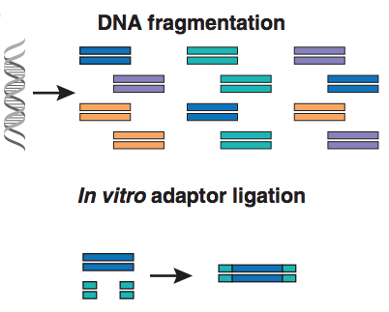
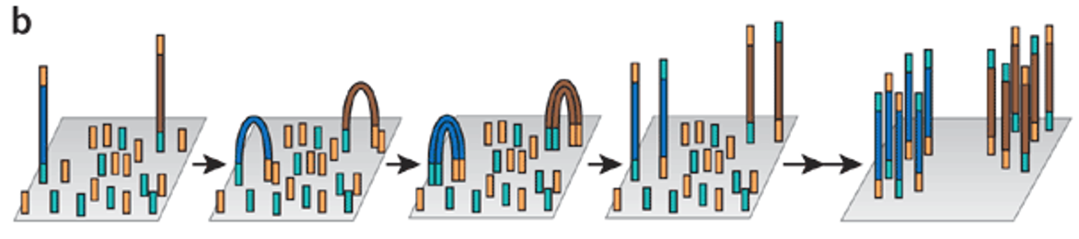
DNA amplification – Bridge PCR
Adaptor ligation
Bridge PCR on slides
(Illumina)
Nature Biotechnology, 2008, 26: 1135-45

Slide 11
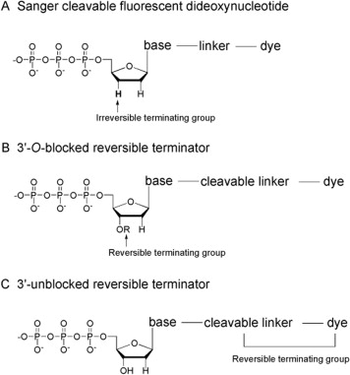
Reversible terminator chemistry
Sanger
^{dye}T*
3’A C T 5’
^{dye}G*
^{dye}A*
^{dye}C*
^{dye}T*
T
^{dye}G*
Illumina
^{dye}A*
T
G
Chen et al., 2013, Genomics Proteomics Bioinformatics, 11:34–40.
Notes:
Hydroxyl group

Slide 12
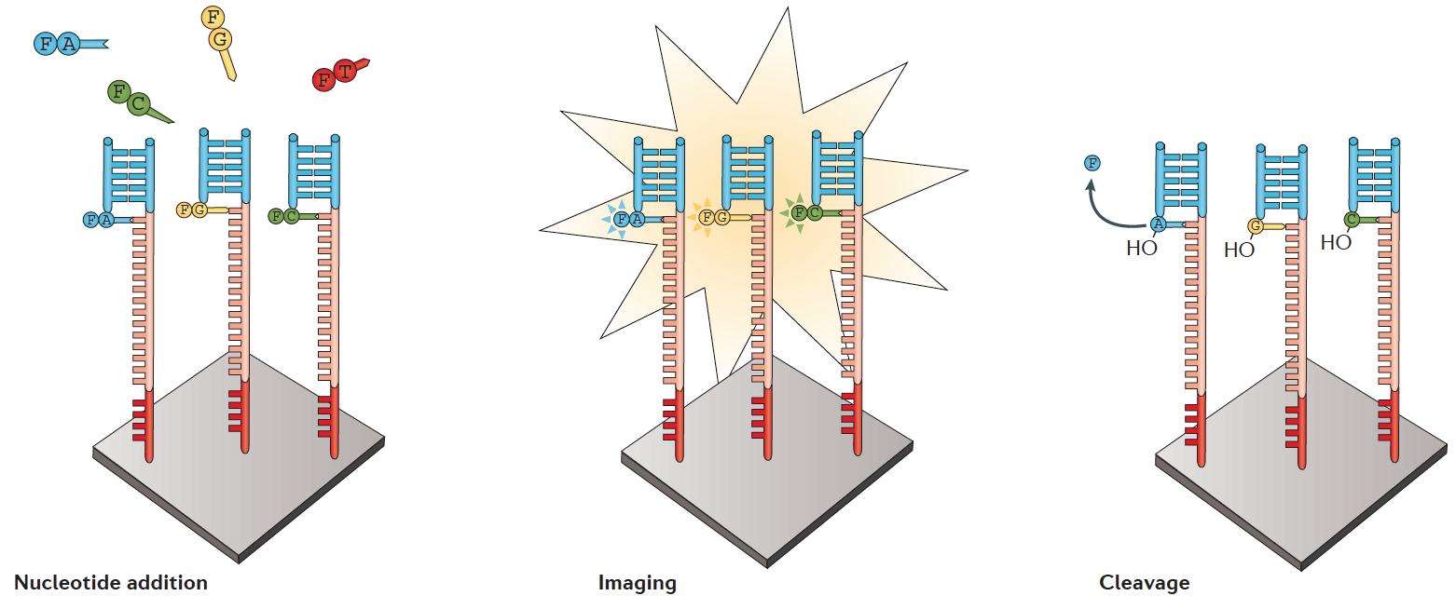
Sequence reading
Reversible terminator chemistry

Slide 13
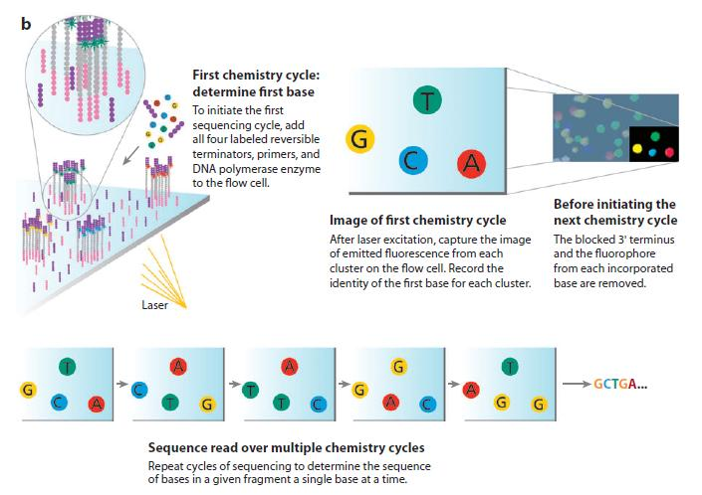
Illumina sequencing

Slide 14
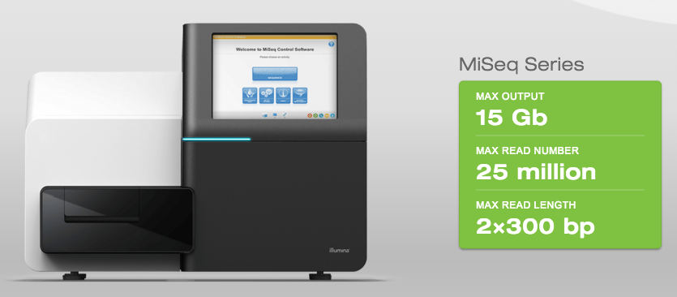
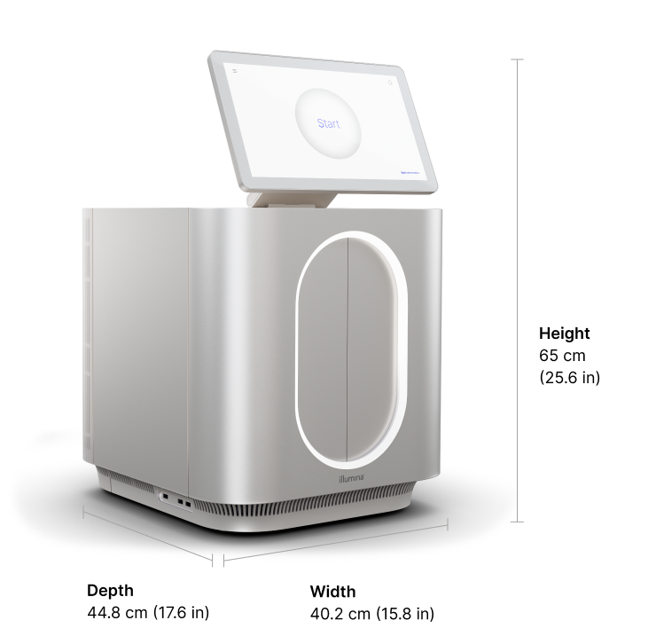
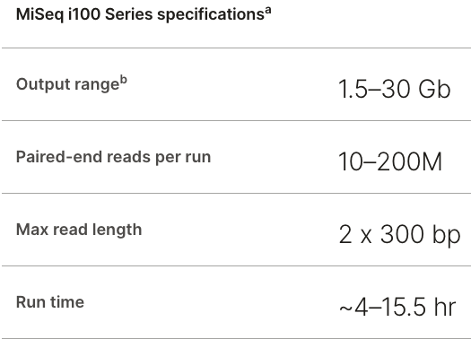
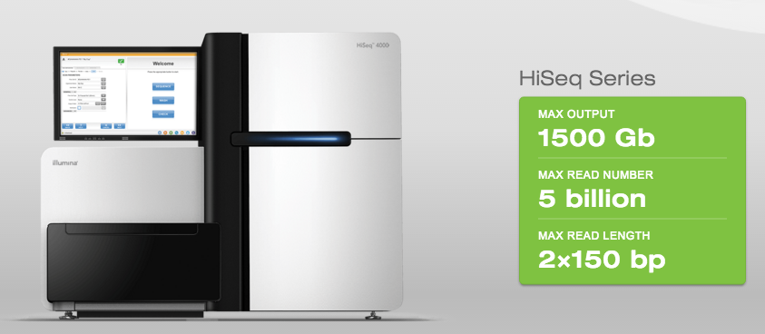
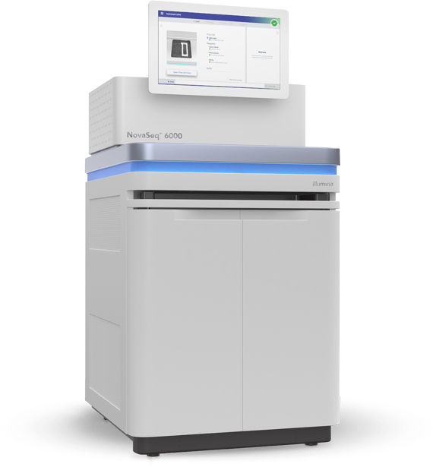
Illumina Sequencers
NovaSeq
MiSeq i100 video

Slide 15
When the single molecular sequencing technology is ready, amplification or cloning is not necessary.

Slide 16
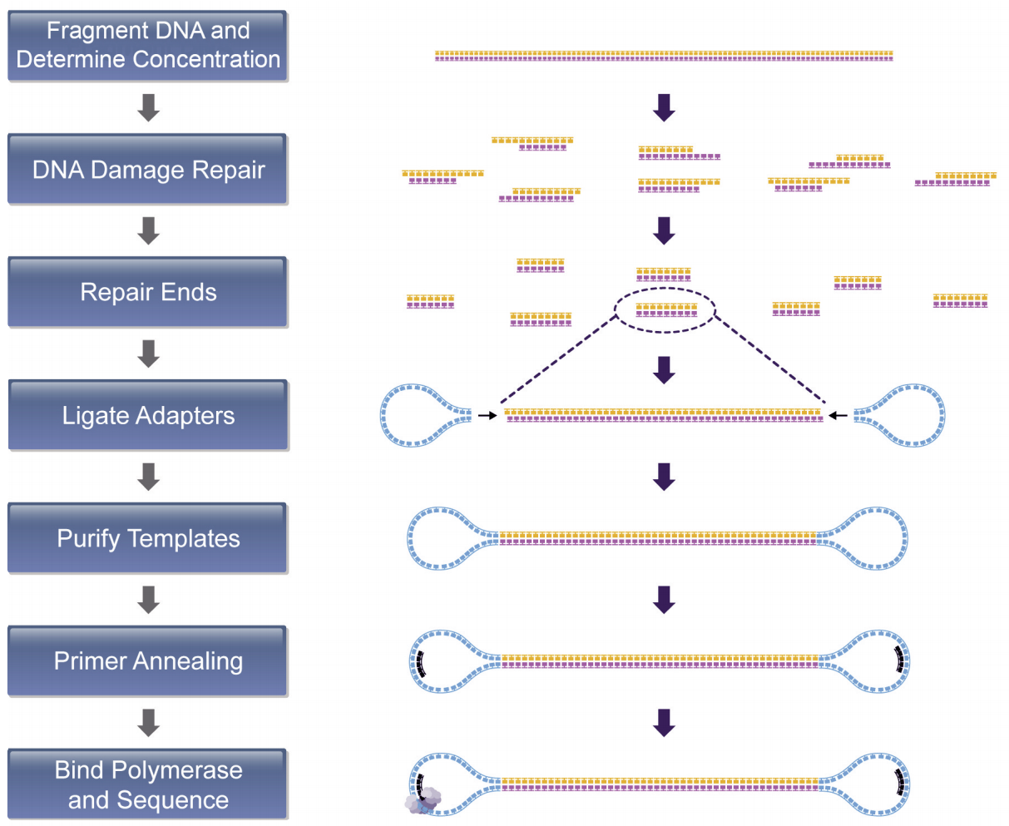
PacBio library prep workflow
SMRTbell adaptor

Slide 17
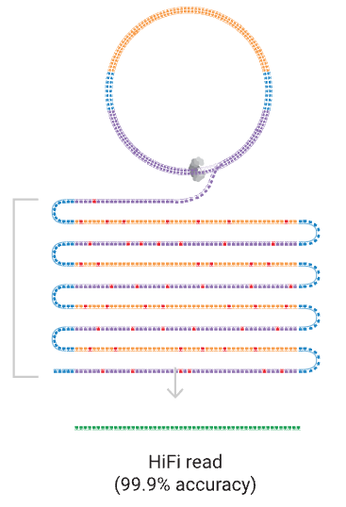
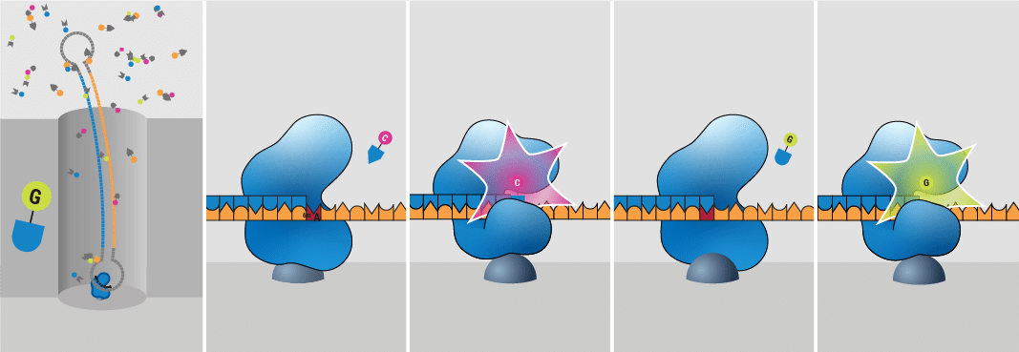
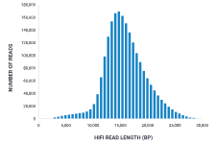
PacBio – Single Molecule Real Time (SMRT)
Up to 25 kb with
>99% accuracy
PacBio HiFi video

Slide 18
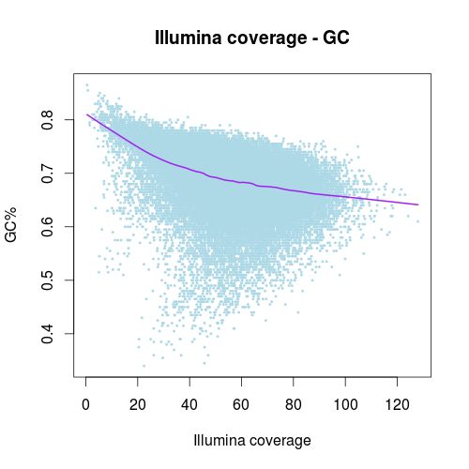
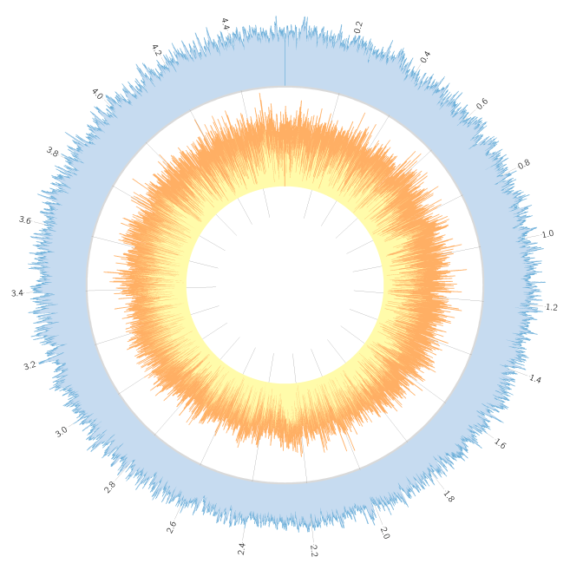
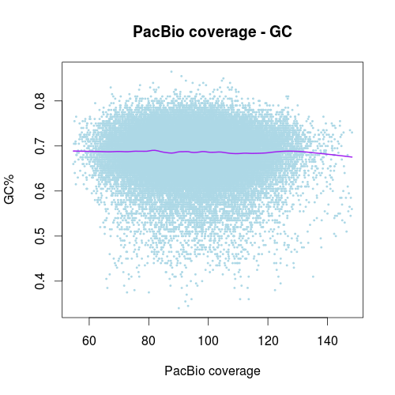
Less biases (e.g., GC content)
Coverage map (depth per region)
PacBio
Illumina
Peng et al., BMC Genomics, 2016, 17:21

Slide 19
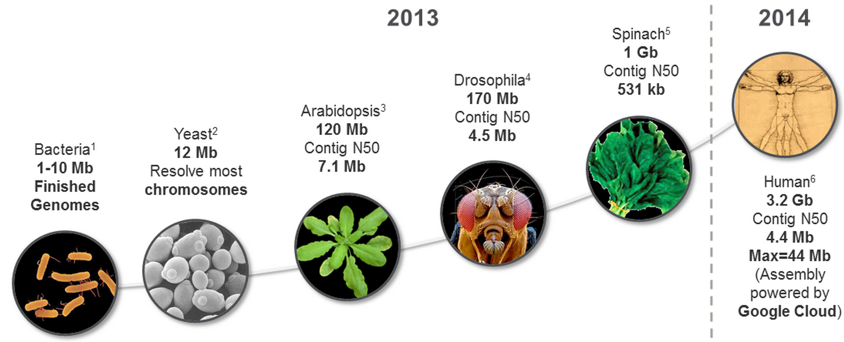
Early-generation PacBio for genome assembly
PacBio has solved de novo assemblies of most bacterial genomes and it will solve assemblies of small “simple” genomes (e.g., <500 Mbp) with increasing read length and improved sequencing quality.

Slide 20
Major long-read technologies
Notes:
Jonathan Rothberg (454 + Ion Torrent)

Slide 21
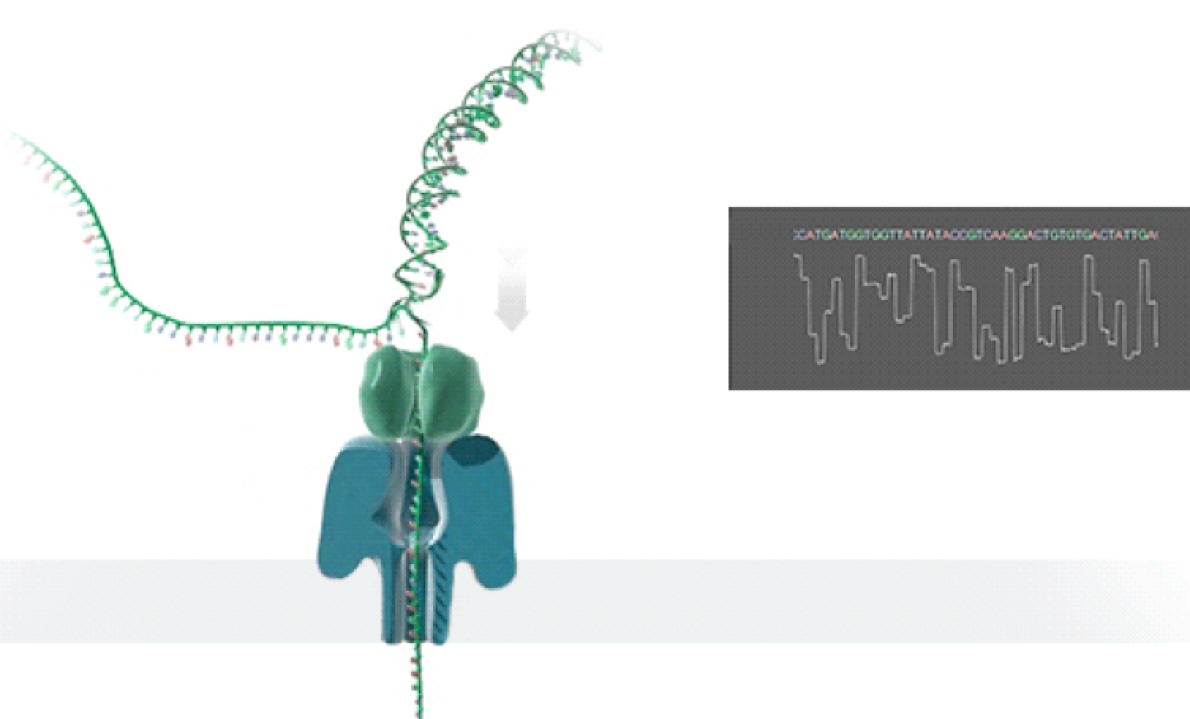
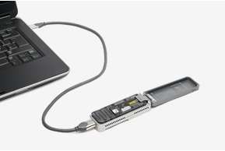
Oxford Nanopore A promising technology
Single molecular sequencing
No amplifications
Long reads (typically 10-200kb)
Error rate is high (~1-10%)
As each nucleobase passes through the pore the current is affected and this change allows sequence to be read out.
Notes:
10

Slide 22
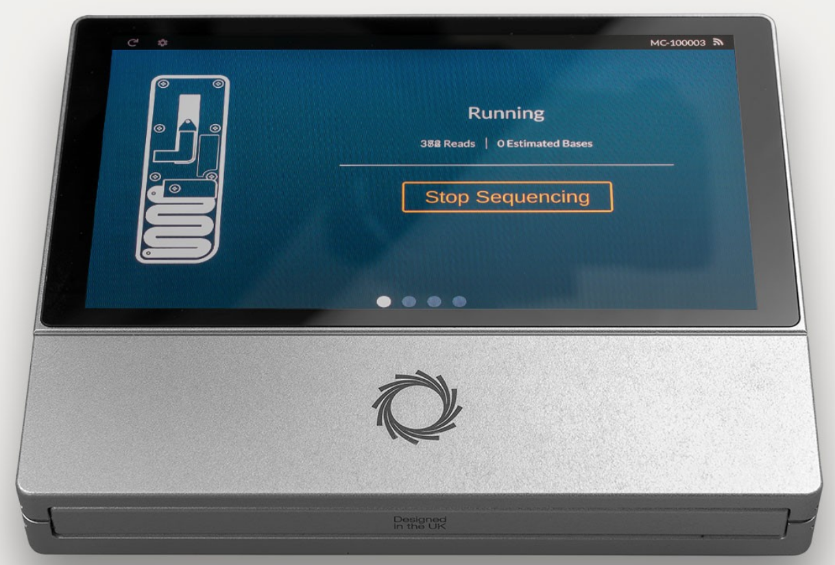
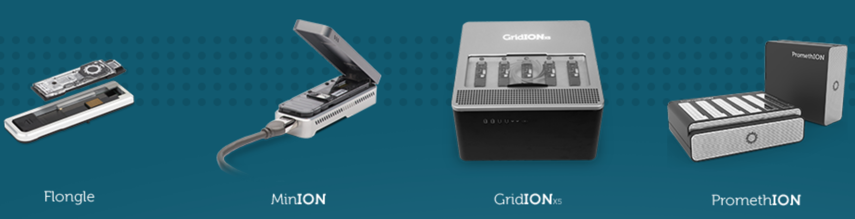
Nanopore devices
MinION
USB disposable sequencer
~10Gb in about two days
PromethlON
High-throughput
lower cost (<$1000 per human genome)
portable device:
MinION Mk1C

Slide 23
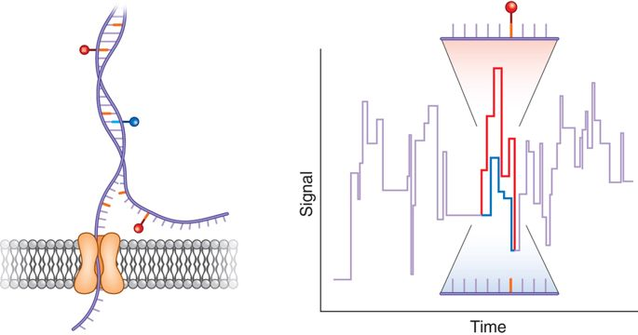
Applications of Nanopore sequencing
1. Genomic DNA sequencing
2. RNA sequencing (direct RNA or cDNA)
3. DNA methylation and other modifications
Nature Methods, 2017, 14:347–348

Slide 24
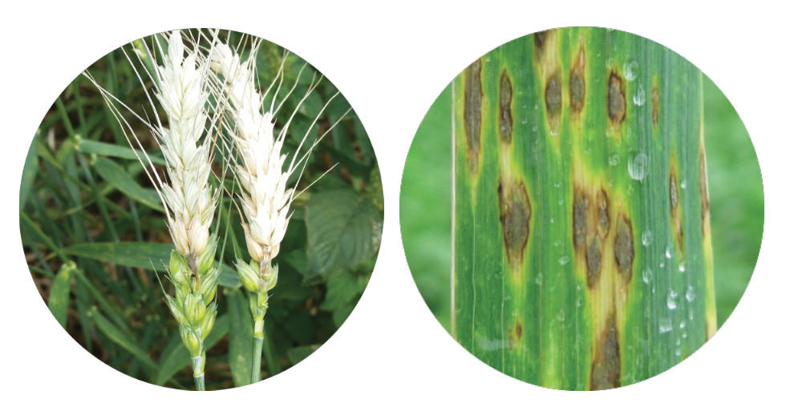
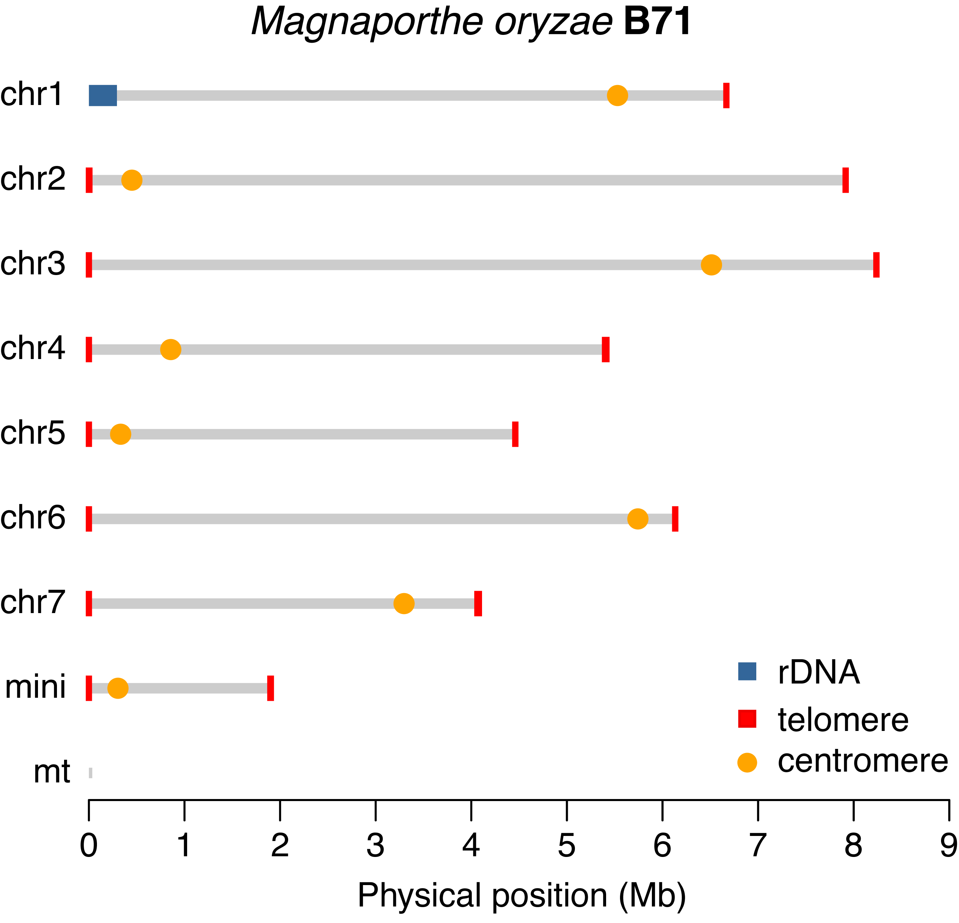
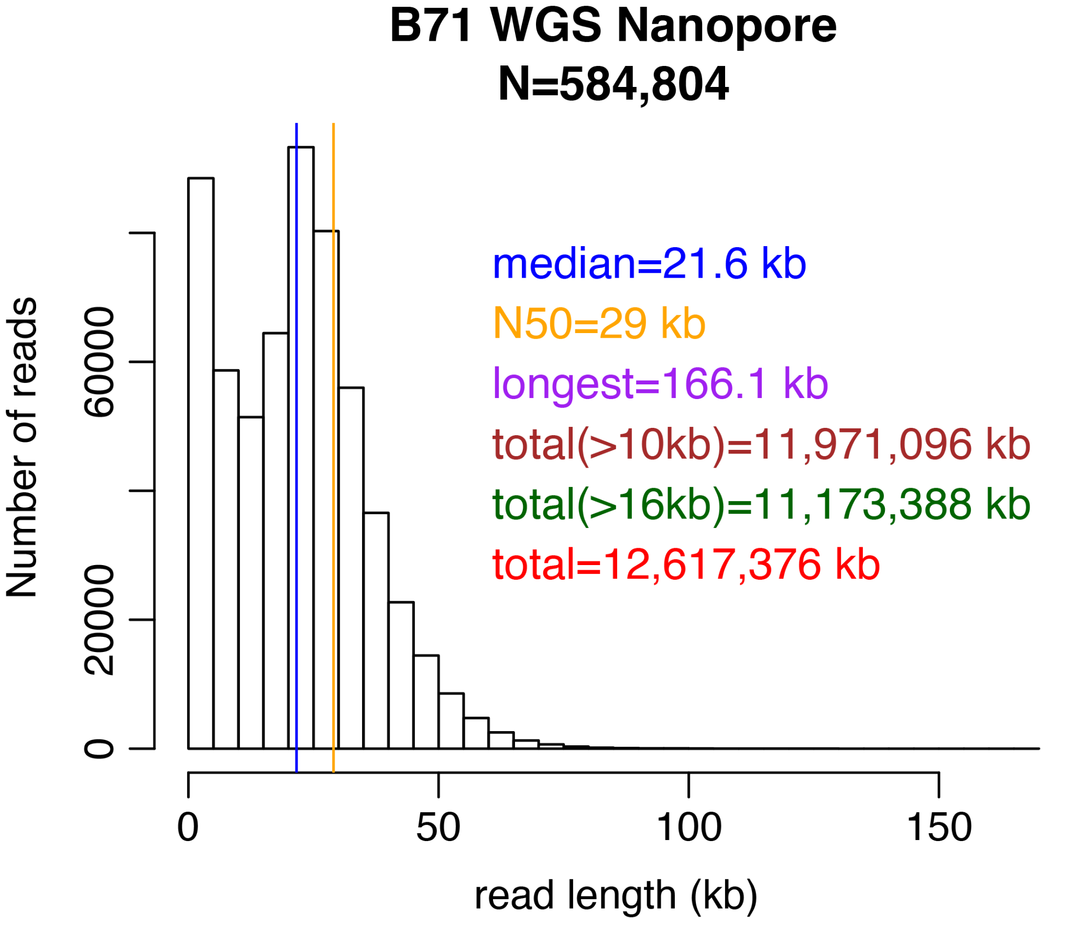
Finished genomes can be generated using Nanopore data
Liu et al., 2023, New Phytologist

Slide 25
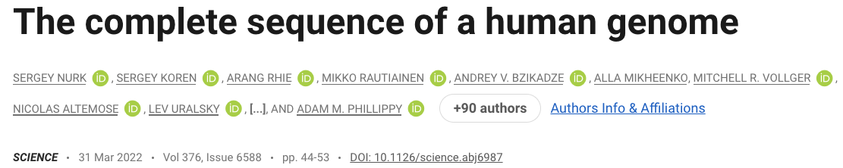
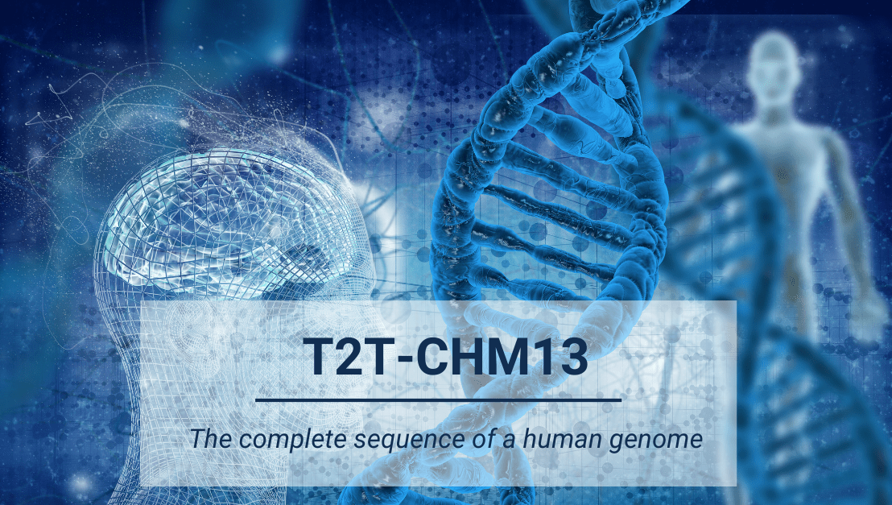
To finish the last remaining regions of the genome, we leveraged the complementary aspects of PacBio HiFi and Oxford Nanopore ultralong-read sequencing to assemble the uniformly homozygous CHM13hTERT cell line.

Slide 26

Method of the Year 2022: Long-read sequencing
The two most widely used commercial technologies are Pacific Biosciences’ Single Molecule Real-Time (SMRT) sequencing (average read length ~20 kb with >99.9% accuracy for HiFi reads) and Oxford Nanopore Technologies’ nanopore sequencing (average read length ~100 kb for ultra-long reads, ~99% accuracy for R10.4).

Slide 27
Sequence errors and read lengths
Nanopore
(InDel)
PacBio-HiFi
Read length
Sanger
Illumina
(substitution)
LOW
HIGH
Sequencing Error

Slide 28
Case study
De novo assembly of a strain of E.coli
Human whole genome sequencing for SNP discovery
Which platform(s)?
Sequencing depth?

Slide 29
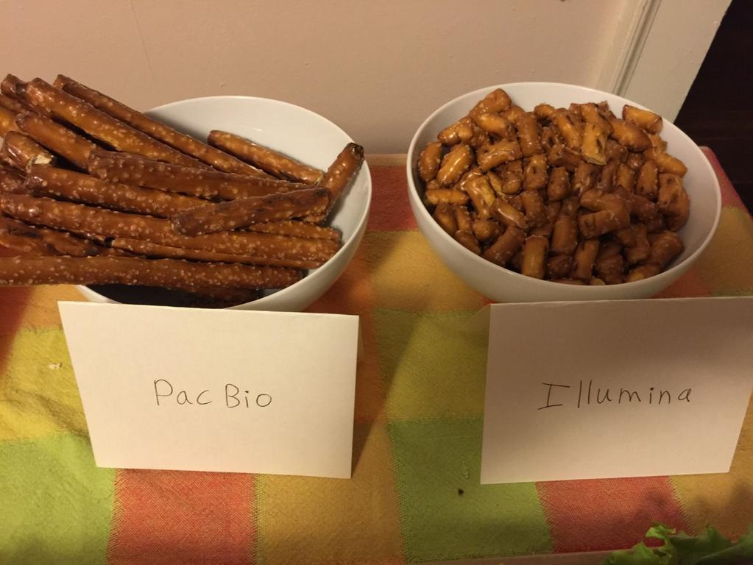
Sequence platforms
Illumina (MiSeq, HiSeq, NovaSeq)
very high throughput, up to 2x300 bp, and high accuracy (<1%)
PacBio HiFi
Up to 25 kb, <1% error
Nanopore
Moderate sequencing throughput, very long (could be >1 Mb), errors (1-10%)
@anne_churchland (twitter)

Slide 30
Experimental design
Goal
Platform
Read length
Rate and type of sequence errors
Sequencing depth
Replication
Biological control
Budget
Platform | Templates | Signal | Read length | Run time | reads per run | Error type | Error rate
Illumina Miseq | PCR or PCR-free | fluorescent | up to 2x300 | 1-2 days | Up to 10 Gb | substitutions | ~0.1-1%
Illumina Hiseq | PCR or PCR-free | fluorescent | up to 2x250 | days | Hundreds of Gb | substitutions | ~0.1-1%
PacBio (HiFi) | Amplification not required | fluorescent | ~10,000 | 30min | 500 Mb – 1 Gb | InDel | <1%
Nanopore | Amplification not required | Electronic flow change | >10,000 | hours | >5Gb per MinION | InDel | 1-10%

Slide 31
Illumina platforms and terminologies Illumina video
Library preparation
Sequencing lane
Index (barcode)
Single-ends and paired ends
Read length

Slide 32
COMMON in all NGS platforms
Input
RNA/DNA
Adaptor is required for library preparation
DNA Library
Thousands to hundreds of millions of fragments are sequenced in parallel
Sequencing
Standard data (e.g., FASTQ) are output
Data
Output

Slide 33
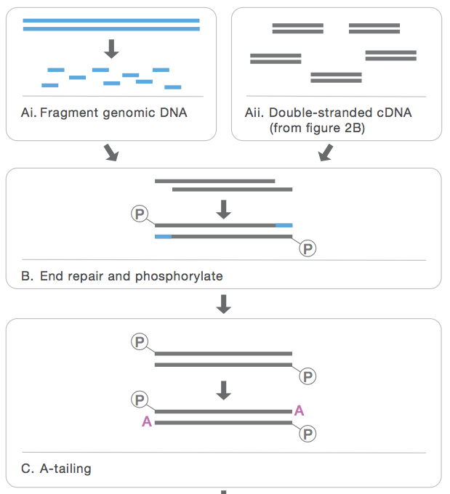
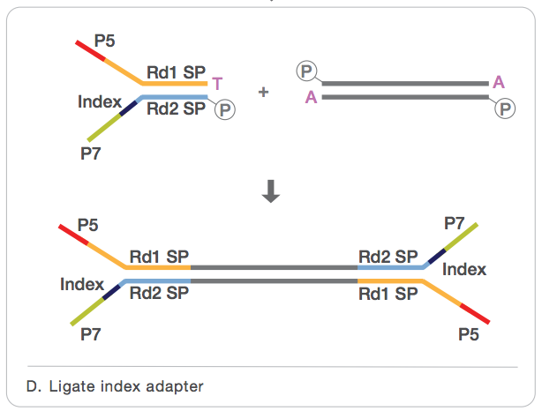
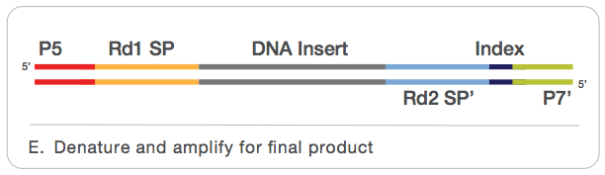
Illumina library preparation (TruSeq)
Y-adaptor
a.
b.
Fragmentation
End-repair
Final product
PCR or PCR-free
A-tailing
From TruSeq Manual

Slide 34
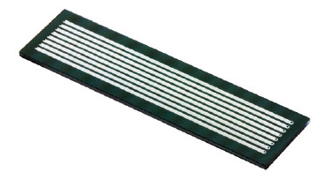
Multiplexing (DNA barcode/Index)
flowcell
lane
Illumina HiSeq4000
1500 Gb
Up to 400 million reads
• Data from a lane are more than needed in many cases
• Multiplexing: To put multiple samples in a lane via using DNA barcodes to distinguish samples

Slide 35
Barcode / Index
AGTGCAxxxxxxxxxxxx
AGTGCAxxxxxxxxxxxx
AGTGCAxxxxxxxxxxxx
CATGTCxxxxxxxxxxxx
CATGTCxxxxxxxxxxxx
CATGTCxxxxxxxxxxxx
sample 1
sample 2

Slide 36
Single-end sequencing
A single read is generated for each template/cluster
“Read” could be 36-300 bp
typically 200-500 bp
Insert size

Slide 37
Paired-end sequencing
Two reads are generated for each template cluster.
The 1st is from one end with one primer.
The 2nd is for the other end with the other primer.
Read 1
Fix size
Read 2

Slide 38
Summary
NGS platforms
Pro and con of each platform
Approaches for library preparation

